Slide 1
High performing students
Do they reach to their potential?
Het Nieuwe Eemland Greet de Boer
Amersfoort Nov. 15th 2016

Slide 2
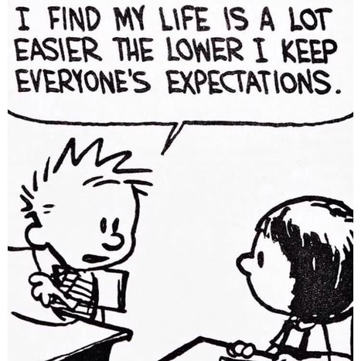
High performing students
Workshop program
Introduction
Characteristics of high performing students
(Cognitive and emotional) needs of high performing students
Differential activities to meet their needs
Proving or improving their competence?
Motivated to learn – Basic Psychological Needs
Support by the learning environment
How do you teach?
Conclusion

Slide 3
Characteristics of high performing students
Group:
write down common characteristics of
high performing students
Individually:
write down characteristics of high performing students
Individually:
write down characteristics of high performing students
Individually:
write down characteristics of high performing students
Individually:
write down characteristics of high performing students

Slide 4
Needs of high performing students
Cognitive and emotional needs
Activities to meet those needs

Slide 5
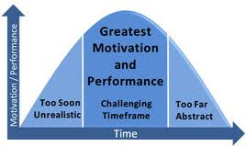
Learning or performance goals?
Goal-orientations – purposes or reasons
for engaging in achievement behaviors (Pintrich, 2003), and
why persons want to get tasks correct, and
how they approach and engage in the tasks.
Task-focused
Task-involved goals
A focus on learning, mastering and developing new skills
Trying to gain understanding or insight
LEARNING or MASTERY goals
Ability focused
Ego-involved goals
A focus on demonstrating ability, attempting to best others
Striving to be the best in the group or class
PERFORMANCE goals
(Schunk et al., 2008)

Slide 6
Learning oriented = ‘improving competence’
Concept = effort leads to success (Nicholls, 1989)
Concept = capability to improve, changeability
Prefer challenging assignments
Prefer tasks from which the results represent their learning process
Output = personally pleased, intrinsically encouraged after a difficult task
When at risk (too difficult, but important): more effort

Slide 7
Performing oriented = ‘proving competence’
Concept = competence leads to success (Ames, 1992; Pintrich, 2000)
Concept = to demonstrate to others that they are competent
Prefer tasks which show their excellence (to do better than other students)
Output = competition, winning with public recognition
At risk (too difficult, but important): helpless, ‘I can not do this’, avoiding or procrastination

Slide 8
Goal orientations (Elliot, 1999; Minnaert, 2015; Schunk et al., 2008)
 | Mastery orientation (focus on learning, understanding) | Performance orientation (focus on best or highest grades)
Goal | Mastery a task Enjoyment and freedom Improving competence | High grades Best at tasks in comparison to others Proving competence
Failure | Need more time/ exercise for mastery/ understanding the subject/ task | Worries about/ be afraid of image of incompetence
Experience of negative emotions when . . | Coercion Lack of autonomy | Signals of criticism Too high a risk / insecurity Loss of control and prestige
Effects | To overcome a challenge To adjust their strategy and increase their effort | Do not learn from their faults Minimize their efforts in the eyes of others

Slide 9
Motivational model of context, self, action, and outcomes
(Deci & Ryan, 2008; Minnaert, 2005)
Context
‘Self’
Action
Outcome
Compe-
tencies/
skills
Structure
Competence
Motivation/
Engagement
Self
regulated
learning
Autonomy-
support
Autonomy
Personal
and social
development
Involvement
Relatedness
Self-Determination Theory, Deci & Ryan, 2000)

Slide 10
Basic Psychological Needs¹
Need for COMPETENCE
the need to experience oneself as effective in one’s interactions with the environment and experiencing opportunities to exercise and express one’s capacities (Deci & Ryan; deCharms; Connell & Wellborn; Krapp)
effects:
*stimulates task-engagement
*stimulates ‘deep-level thinking processes’
*leads to task-orientation and a sense of confidence and
effectance in action
Minnaert (2005)

Slide 11
Basic Psychological Needs²
Need for AUTONOMY (self-determination)
the innately desire to act according to one’s genuine desires and preferences, to show courses of action that reflect one’s true selves, and to experience one selves as the source of one’s actions (Connell & Wellborn; deCharms; Deci & Ryan; Krapp; Skinner & Edge)
effects:
*interest and goal orientations
*effort and results (because of perceived competence)
*rapprochement in behavior versus avoiding in behavior
Minnaert (2005)

Slide 12
Basic Psychological Needs³
Need for relatedness
desire to feel connected, and to be accepted by significant others, to caring for and being cared for by those others (Connell & Wellborn; Deci & Ryan; Krapp)
effects:
*self worth and acceptance by others
*well-being and mental health
*‘task completion’ and depth processing
Minnaert (2005)

Slide 13
Support by the environment
Structure = amount and clarity of information given to students about the way to achieve teacher’s expectations and desired educational outcomes (Jang et al., 2010; Skinner & Belmont, 1993)
Autonomy-support = allowing students to act according to their personal values and interests, so that it provides them a sense of volition and psychological freedom (Reeve, 2009)
Involvement = the extent to which teachers show positive interest in students by trying to know more about them, taking time for them, etc. (Skinner & Belmont, 1993; Skinner, Wellborn & Connell, 1990)

Slide 14
Questionnaire Learning Environment (Belmont, 1992)
Questionnaire to find out the extent to which you meet students’ basic psychological needs
Fill out the questionnaire.
What is your score?
To what extent do you meet students’ basic need for:
  Competence
  Autonomy
  Relatedness
Compare your results with those of your colleagues
What is your conclusion?
What can you do to stimulate your students to learn?

Slide 15
Motivating learning environment by motivating teaching styles
Structure by: clear defined rules and clear communication about expectations and desired outcomes
clearly stated procedures and orderly classroom environment
clear communication about goals and meaningfulness /utility
adapting to students’ level
Scale B
Autonomy- emphasizing ‘mastery’ goals (task orientation)
support by: offering choices, taking into account individual differences between students
a responsive/encouraging and supportive teaching approach
showing respect for students’ opinion
explaining the relevance of the content
Scale C
Involvement showing interest for students’ activities
by: paying attention to and spending time with all students
trusting students in their sincerity and commitment to school
knowing students’ name
Scale A

Slide 16
Thank you for your attention
Greet de Boer g.deboer@cps.nl

