Slide 1
Let’s
School of Palekastro

Slide 2
What is Kahoot?
A game that based on classroom’s response system for creating QUIZES, DISCUSSIONS, SURVEYS

Slide 3
Two important websites:
https://getkahoot.com/
https://kahoot.it

Slide 4
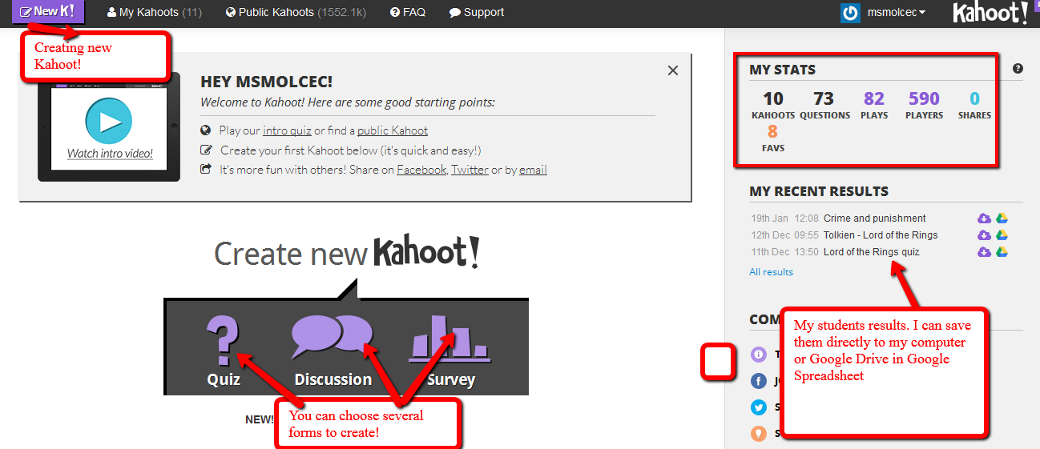
How does it work?
Very simple to use!

Slide 5
Easy platform

Slide 6
You can...
- add images and videos
- edit your quiz when ever you want
- share quiz directly on social networks

Slide 7
When quiz is ready...

Slide 8
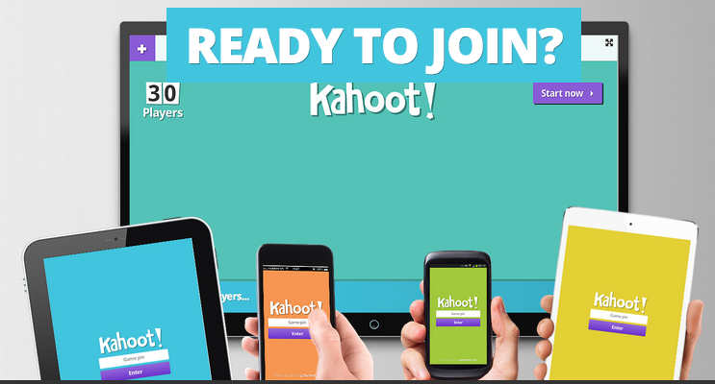
Add the Room PIN and your NAME

Slide 9
Students’ names appear and you are ready to start!
Image CREDIT: https://srahuff.wordpress.com/2014/04/16/kahoot/

Slide 10
On the main screen

Slide 11
On students’ devices

Slide 12
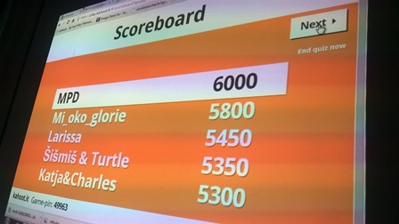
Scoreboard

Slide 13
Your kahoot! quiz list

Slide 14
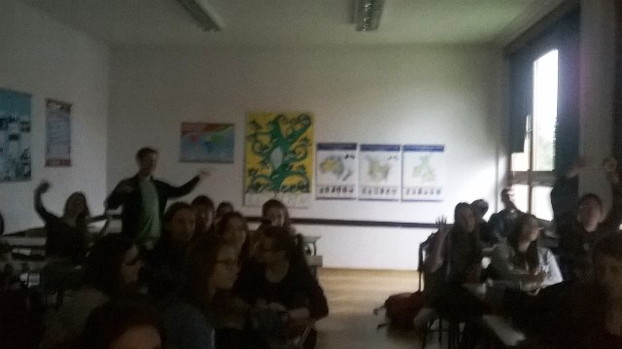
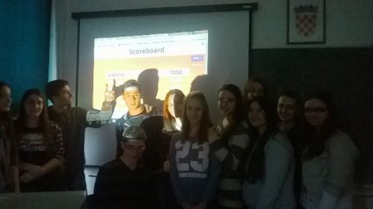
Students love it!
Check out the excitement!

Slide 15
Are you READY?
Let’s Kahoot!!!
☺
School of Palekastro

